Slide 1
CSE101-Lec#25
Nested Structures and Unions

Slide 2
Nested Structure
Nested structures are structures as member of another structure.
We can also take objects of one structure as member in another structure.
Thus, a structure within a structure can be used to create complex data application.
Dot operator is used twice because we are accessing first structure through the object of second structure.

Slide 3
Nested Structure
Two ways of declaring structure within structure or Nested structure:
Declare two separate structures
Embedded structures

Slide 4
Example
struct Date
{
int dd;
int mm;
int yy;
};
struct Student
{
char name[20];
int rollno;
int marks;
struct Date dob;
};
Here structure Student is nesting structure and structure date is nested structure

Slide 5
Example: embedded structures
struct Student
{
char name[20];
int rollno;
struct date
{
int dd;
int mm;
int yy;
} dob;
};
Notes:
Structure date is not having independent existence

Slide 6
WAP to read and display the car number, starting time and reaching time using structure within structure.
#include<stdio.h>
void main()
{
struct time{
int second;
int minute;
int hour;
};
struct car
{
int carno;
struct time st;
};
struct car myCar;
printf(“\n car no. starting time reaching time:”);
scanf(“%d”, &myCar.carno);
scanf(“%d %d %d”, &myCar.st.hour, &myCar.st.minute, &myCar.st.second);
printf(“\n%d”, myCar.carno);
printf(“\t %d:%d:%d \t” myCar.st.hour, myCar.st.minute, myCar.st.second);
}

Slide 7
Unions
Unions are conceptually similar to structures.
The syntax to declare/define a union is also similar to that of a structure. The only differences is in terms of storage.
In structure each member has its own storage location, whereas all members of union uses a single shared memory location which is equal to the size of its largest data member.
In C, struct and union types cannot have static members.

Slide 8
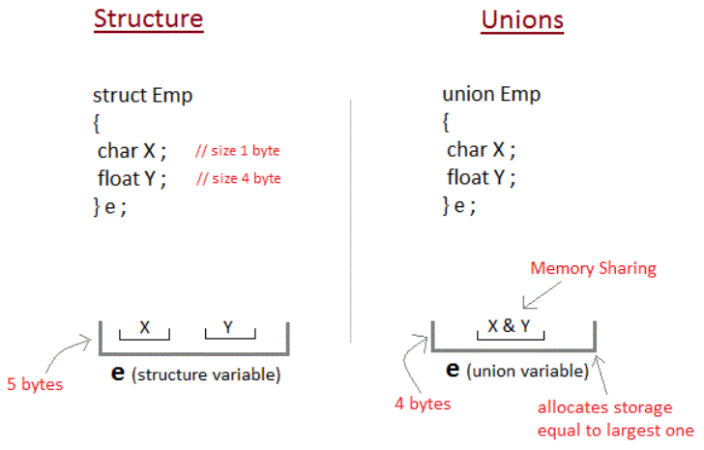
This implies that although a union may contain many members of different types, it cannot handle all the members at the same time. A union is declared using the union keyword.

Slide 9
Union
;
Syntax for accessing any union member is similar to accessing structure members:
union test
{
int a;
float b;
char c;
} t;
t.a; //to access members of union t
t.b;
t.c.

Slide 10

Example
A class is a very good example of structure and union in this example students are sitting in contiguous memory allocation as they are treated as a structure individually.
And if we are taking the place of teacher then in a class only one teacher can teach. After leaving the first teacher then another teacher can enter.

Slide 11
Unions
Valid union operations
  Assignment to union of same type: =
  Taking address: &
  Accessing union members: .
  Accessing members using pointers:

Slide 12
Program using union.
#include<stdio.h>
union job
{
char name[32];
float salary;
}u;
int main()
{
printf("Enter name:\n");
scanf("%s",&u.name);
printf("Enter salary: \n");
scanf("%f",&u.salary);
printf("Displaying\nName:%s\n",u.name);
printf("Salary: %.1f",u.salary);
}

Slide 13
Enter name Hillary
Enter salary 1234.23
Displaying
Name: f%Bary
Salary: 1234.2
Initially, Hillary will be stored in u.name and other members of union will contain garbage value. But when user enters value of salary, 1234.23 will be stored in u.salary and other members will contain garbage value. Thus in output, salary is printed accurately but, name displays some random string.

Slide 14
Enumeration Constants
  To assign names to integral constants, the names make a program easy to read and maintain.
  Example:
  enum flag { const1, const2, ..., constN };
Here, name of the enumeration is flag. And, const1, const2,...., constN are values of type flag.
By default, const1 is 0, const2 is 1 and so on. You can change default values of enum elements during declaration (if necessary).

Slide 15
Why enums are used in C programming?
Enum variable takes only one value out of many possible values. Example:
#include<stdio.h>
enum suit
{
club = 0,
diamonds = 10,
hearts = 20,
spades = 3
} card;
int main()
{
card = club;
printf("Size of enum variable = %d bytes", sizeof(card));
return 0;
}
It's because the size of an integer is 4 bytes. This makes enum a good choice to work with flags.You can accomplish the same task using structures. However, working with enums gives you efficiency along with flexibility.
Output
Size of enum variable = 4 bytes

Slide 16
Enum
// An example program to demonstrate working of enum in C
#include<stdio.h>
enum week{Mon, Tue, Wed, Thur, Fri, Sat, Sun};
int main()
{
enum week day;
day = Wed;
printf("%d",day);
return 0;
}
Output: 2

Slide 17
